Slide 1
CLASS DIAGRAM

Slide 2
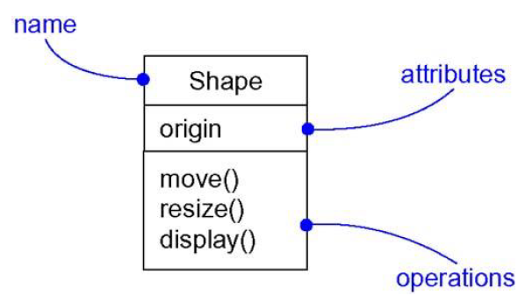
Introduction
Most important building block
Description of a set of objects that share the same attributes, operations, relationships and semantics
Used to capture the vocabulary of the system
Include abstractions of the problem domain
Classes that make up the implementation
Form a part of a balanced distribution of responsibilities across the system

Slide 3
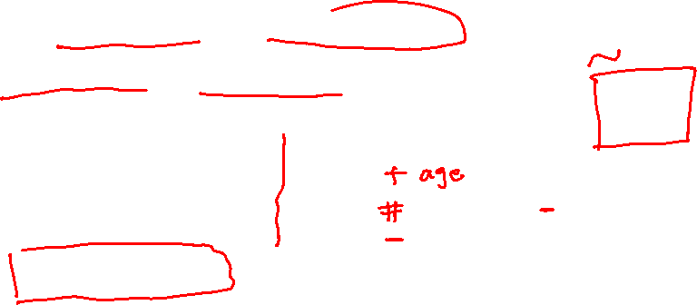
Class
Describes a set of objects having similar:
Attributes (status)
Operations (behavior)
Relationships with other classes
Attributes and operations may
have their visibility marked:
"+" for public
"#" for protected
"−" for private
"~" for package
Class Name
Window
Attributes
size: Size visibility: boolean
Operations
display() hide()

Slide 4
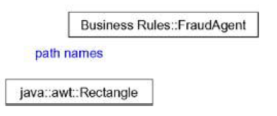
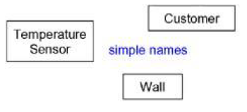

Class Names
Name must be unique within its enclosing package
Simple name and Path name
Class names are noun phrases from the vocabulary of the system

Slide 5
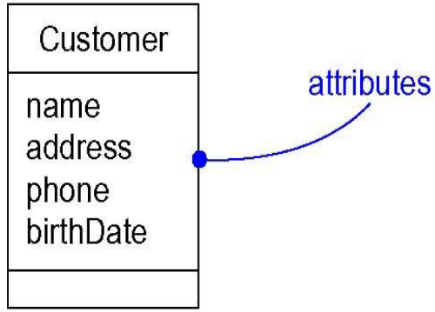
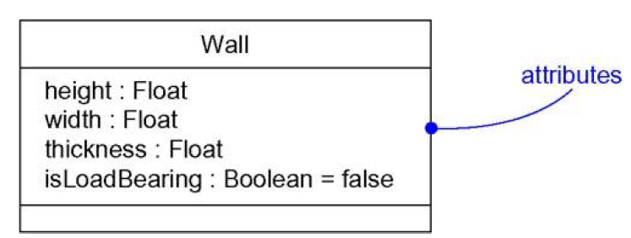

Attributes
Named property of a class
Describes a range of values that instances of the property hold
Shared by all objects of that class
An abstraction of the kind of data or state of an object
At a given moment, an object will have specific values for each of its attributes
Noun phrase that represents some property

Slide 6
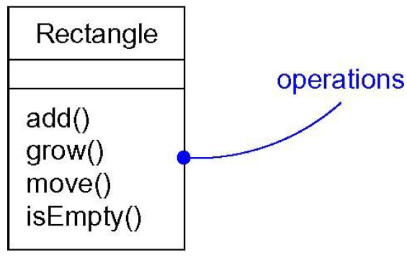
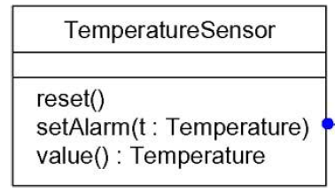
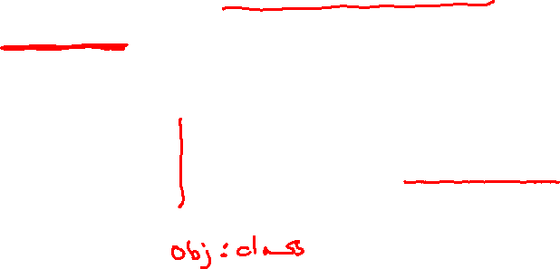
Operations
A service that can be requested from any object of the class to affect behavior
Invoking an operation changes the object’s data or state
Verb phrase representing some behavior of the class

Slide 7
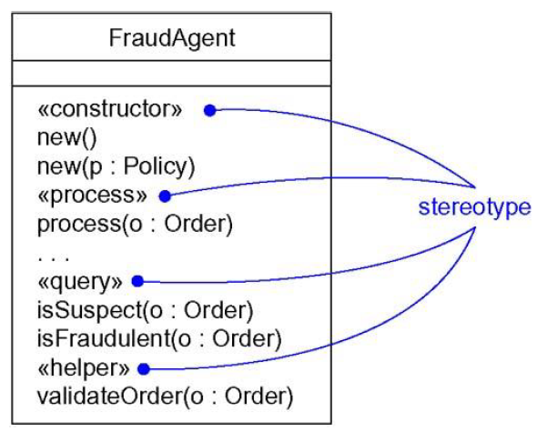
Organizing Attributes and Operations
Don’t have to show every attribute and operation at once
End each list with ellipsis (…)
Can also prefix each group with a descriptive category using stereotypes

Slide 8
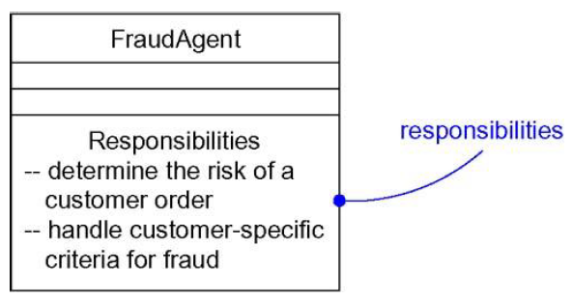

Responsibilities
Is a contract or an obligation of a class
All objects of the class have the same kind of state and behavior
Attributes and operations are the features that carry out the class’s responsibility
TemperatureSensor class responsible for measuring temperature and raising an alarm
Techniques used - CRC cards and use case based-analysis

Slide 9
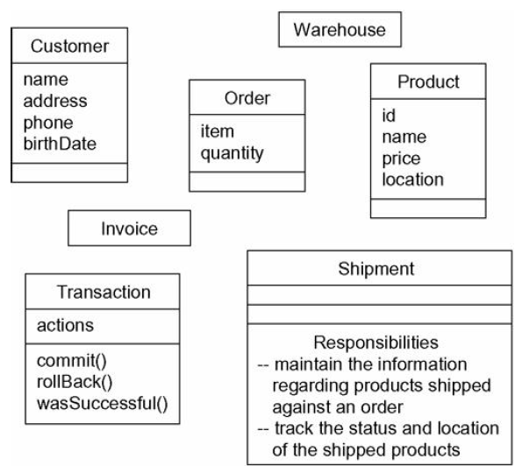
Modeling the Vocabulary of a System
Identify the things that describe the problem
For each abstraction, identify a set of responsibilities
Provide the attributes and operations needed to carry out those responsibilities

Slide 10
CLASS RELATIONSHIPS

Slide 11
Introduction
Classes collaborate with other classes in a number of ways
Three kinds of relationships in OO modeling
Dependencies
Generalizations
Associations
Provide a way for combining your abstractions
Building relationships is not like creating a balanced set of responsibilities

Slide 12
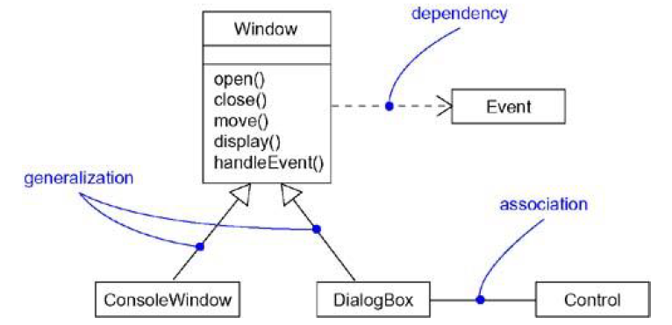
Introduction
Relationship is a connection among things
UML graphical notation
Permits to visualize relationships apart from any specific programming language
Emphasize the most important parts of a relationship
Name
Things it connects
Properties

Slide 13
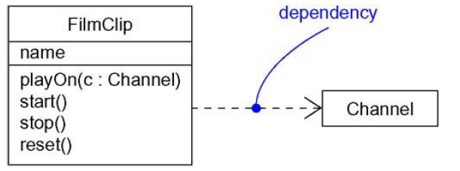
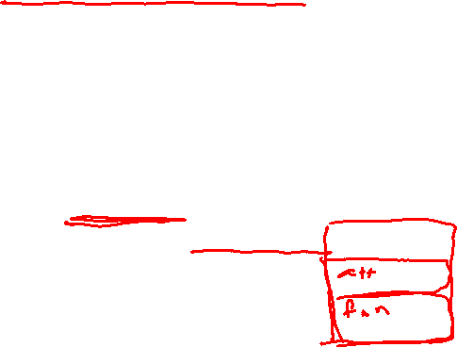
Dependency
Using relationship
States that a change in specification of one thing may affect another thing that uses it
Used in the context of classes
Uses operations or variables/arguments typed by the other class
Shown as an argument in the signature of an operation
If used class changes, the operation of the other class may be affected

Slide 14

Dependency
Dependency is a weaker form of relationship which indicates that one class depends on another because it uses it at some point in time.
One class depends on another if the independent class is a parameter variable or local variable of a method of the dependent class.
This is different from an association, where an attribute of the dependent class is an instance of the independent class.
Iterator
<<friend>>
Vector

Slide 15
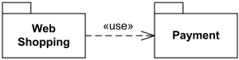
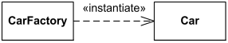
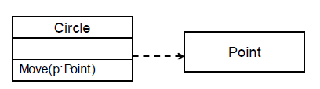
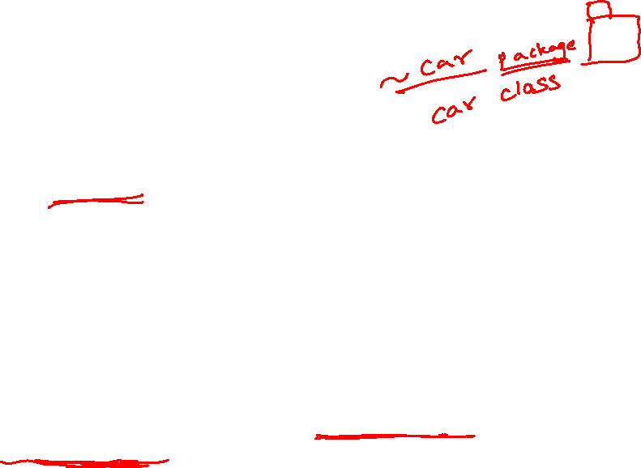
Dependency

Slide 16
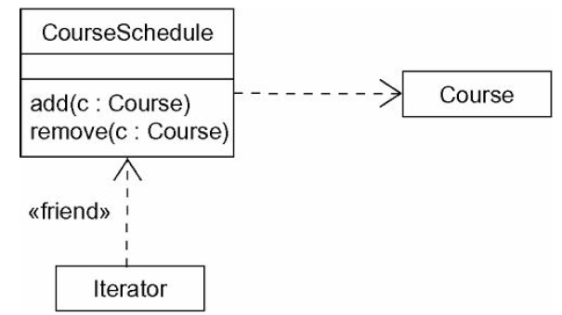
Modeling Simple Dependencies
To model the using dependency
Create a dependency pointing from the class with the operation to the class used as a parameter in the operation

Slide 17
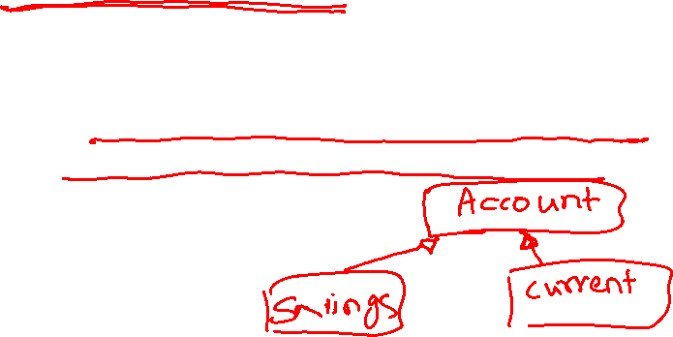
Generalization
Relationship between a general thing (superclass) and a more specific kind of that thing (subclass)
“Is-a-kind-of” relationship
Child is substitutable for the parent
Polymorphism
Operation of child has the same signature as an operation in the parent but overrides it

Slide 18
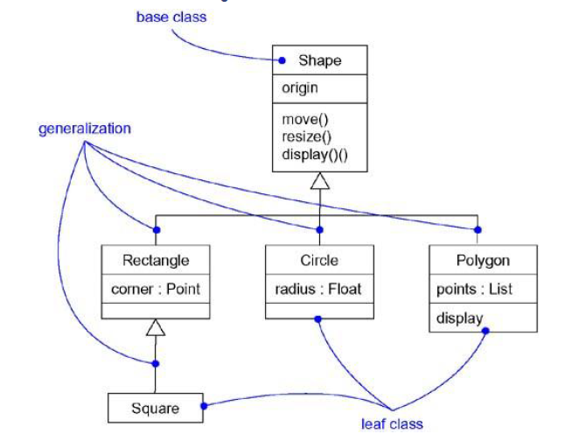
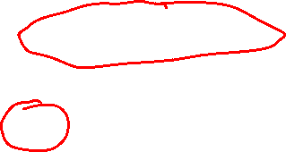
Generalization
{abstract} is a tagged value that indicates that the class is abstract. The name of an abstract class should be italicized
An abstract class
Shape {abstract}
Super Class
Generalization relationship
Circle
Sub Class

Slide 19
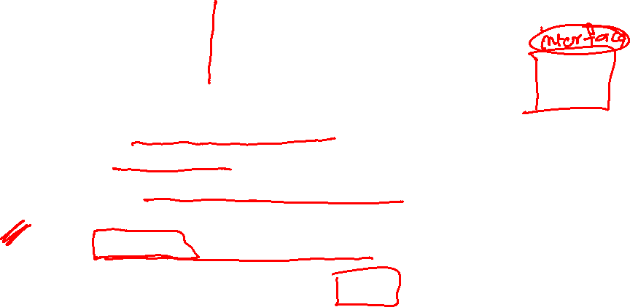
Generalization
A sub-class inherits from its super-class
Attributes
Operations
Relationships
A sub-class may
Add attributes and operations
Add relationships
Refine (override) inherited operations
A generalization relationship may not be used to model interface implementation.

Slide 20
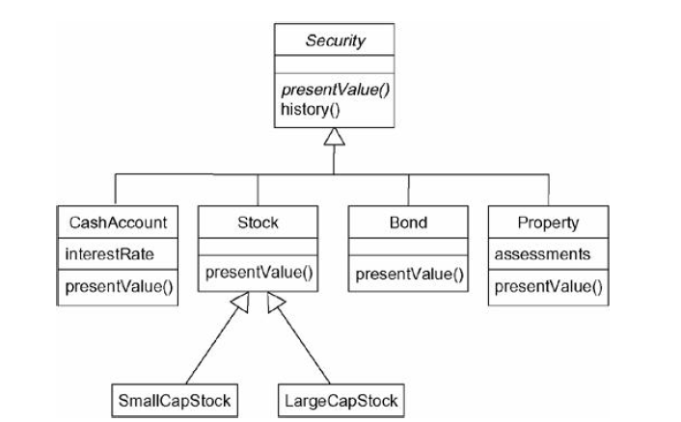
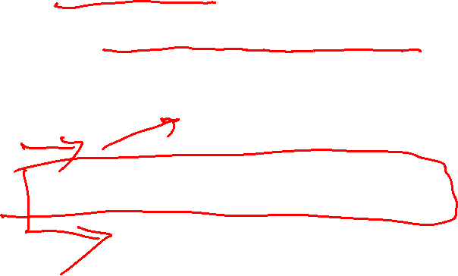
Modeling Single Inheritance
Find classes that are structurally or behaviorally similar while modeling the vocabulary
To model inheritance
Look for common responsibilities
Elevate these to a more general class
Specify that the more specific class inherits from the more general class

Slide 21

Association
Structural relationship
Specifies that objects of one thing are connected to objects of another
Can navigate from objects of one class to the other
Self Association
Connects a class to itself
Binary Association
Connects exactly two classes

Slide 22
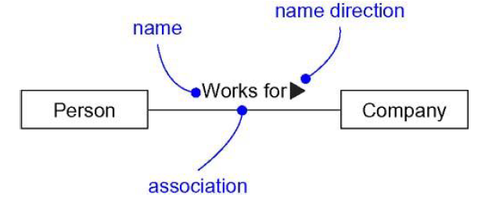
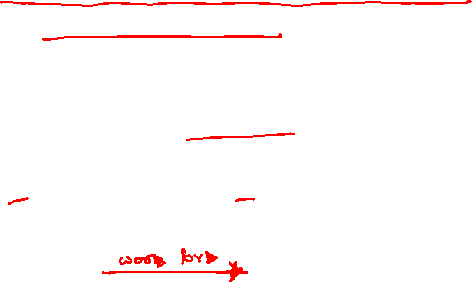
Association : Adornments
Name
Use a name to describe the nature of the relationship
Can give a direction to the name

Slide 23
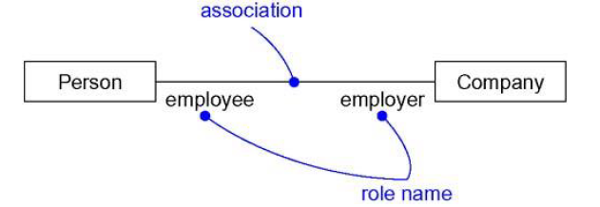

Association : Adornments
Role
The face that the class at the far end of the association presents to the class at the near end
Explicitly name the role a class plays (End name or Role name)
Same class can play the same or different roles in other associations

Slide 24

Association : Adornments
Multiplicity
States how many objects may be connected across an instance of an association
An expression that evaluates to a range of values or an explicit value
Multiplicity at one end of an association means
For each object of the class at the opposite end, there must be that many objects at the near end
Show a multiplicity of
Exactly one (1)
Zero or one (0 . . 1)
Many (0 . . *)
One or more (1 . . *)
State an exact number (ex: 3)

Slide 25
Multiplicity
1:1
1:N
N:1
N:M
Meta character – “*” and “+”:

Slide 26
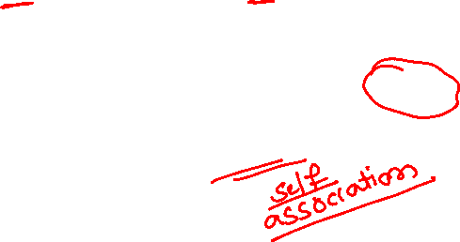
Associations (cont.)
Role name
Association name
StaffMember
instructor
Student
1..*
instructs
*
Navigable (uni-directional) association
Role
Multiplicity
*
pre - requisites
Courses
Reflexive association
0..3

Slide 27
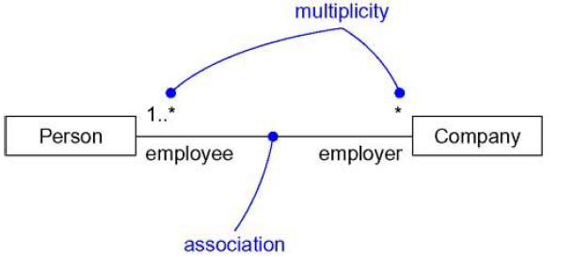
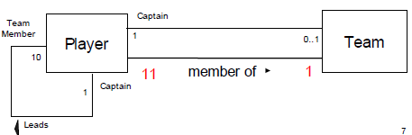
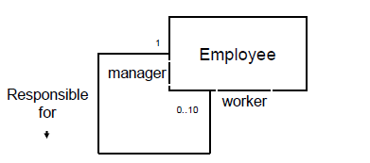
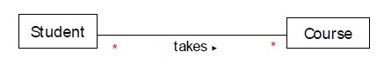
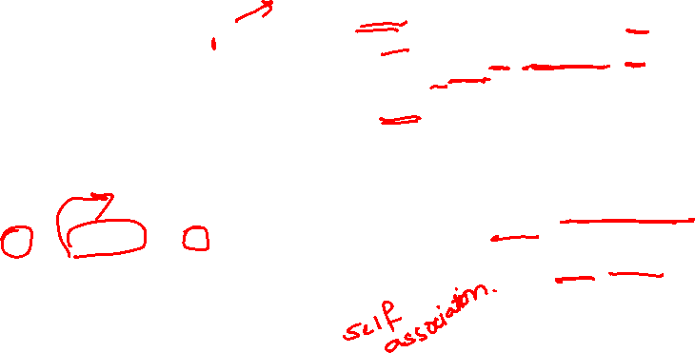
Association : Adornments
Multiplicity
Specify complex multiplicities by using a list, 0..1, 3..4, 6..* (any number of objects other than 2 or 5)

Slide 28
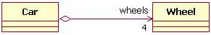

Association : Adornments
Aggregation
Model a whole/part relationship
Represents a “has-a” relationship

Slide 29
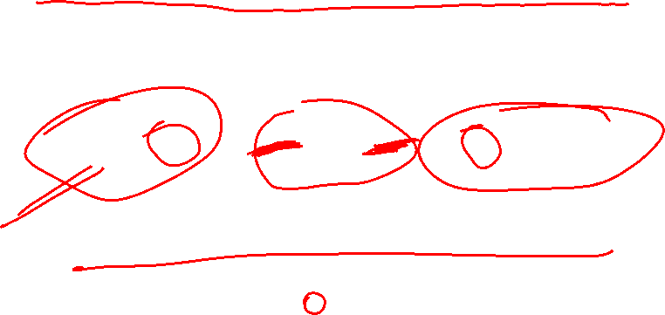
Aggregation
A special form of association that models a whole-part relationship between an aggregate (the whole) and its parts.
Models a “is a part-part of” relationship.
Car
2..*
Door
1..*
House
Whole
Part

Slide 30

Aggregation (cont.)
Aggregation tests:
Is the phrase “part of” used to describe the relationship?
A door is “part of” a car
Are some operations on the whole automatically applied to its parts?
Move the car, move the door.
Are some attribute values propagated from the whole to all or some of its parts?
The car is blue, therefore the door is blue.
Is there an intrinsic asymmetry to the relationship where one class is subordinate to the other?
A door is part of a car. A car is not part of a door.

Slide 31
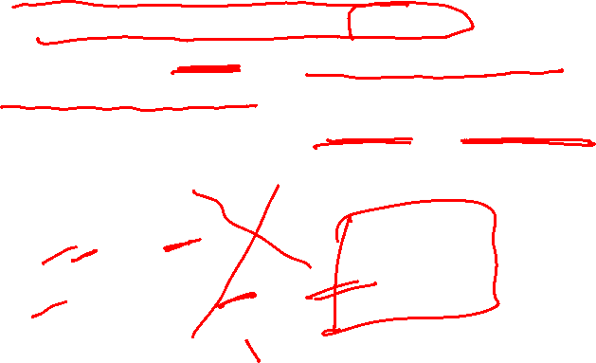
Composition
A strong form of aggregation
The whole is the sole owner of its part.
The part object may belong to only one whole
Multiplicity on the whole side must be zero or one.
The life time of the part is dependent upon the whole.
The composite must manage the creation and destruction of its parts.
Circle
1
Point
Circle
3..*
Point
Polygon

Slide 32

Realization
A realization relationship indicates that one class implements a behavior specified by another class (an interface or protocol).
An interface can be realized by many classes.
A class may realize many interfaces.
LinkedList
<<interface>> List
ArrayList

Slide 33
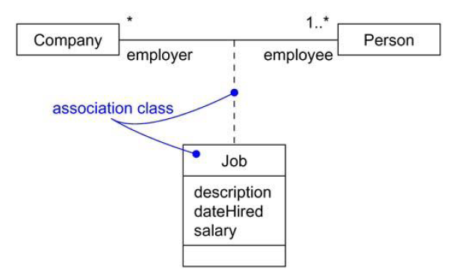

Association
Association Classes
Association itself may have properties
Ex: In the relationship between a Company and a Person, there is Job that represent the properties of that relationship
Represents exactly one pairing of Person and Company
Modeling element that has both association and class properties
Can’t attach an association class to more than one association

Slide 34
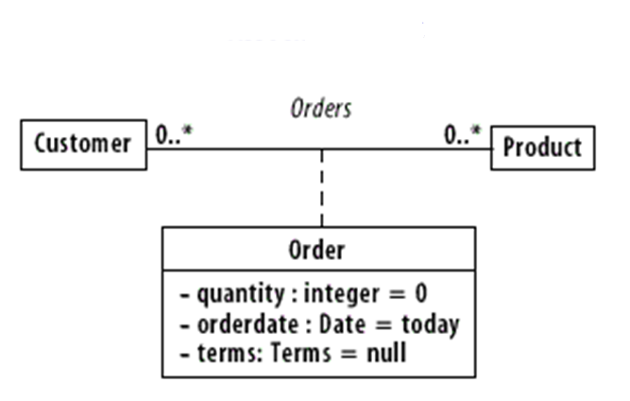
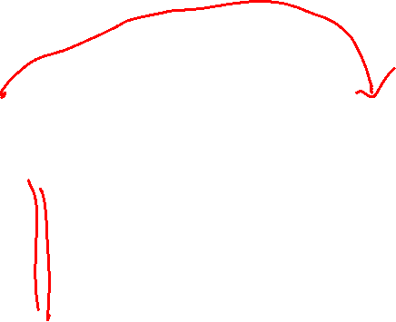
Association Class
.

Slide 35
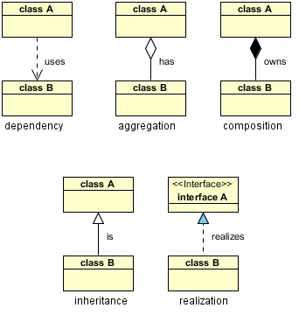


Slide 36
Associations
An association between two classes indicates that objects at one end of an association “recognize” objects at the other end and may send messages to them.
Example: “An Employee works for a Company”
Employee
Company

Slide 37
Associations (cont.)
To clarify its meaning, an association may be named.
The name is represented as a label placed midway along the association line.
Usually a verb or a verb phrase.
A role is an end of an association where it connects to a class.
May be named to indicate the role played by the class attached to the end of the association path.
Usually a noun or noun phrase
Mandatory for reflexive associations

Slide 38
Associations (cont.)
Multiplicity
the number of objects that participate in the association.
Indicates whether or not an association is mandatory.
Multiplicity Indicators
Exactly one | 1
Zero or more (unlimited) | * (0..*)
One or more | 1..*
Zero or one (optional association) | 0..1
Specified range | 2..4
Multiple, disjoint ranges | 2, 4..6, 8

Slide 39
Aggregation
A special form of association that models a whole-part relationship between an aggregate (the whole) and its parts.
Models a “is a part-part of” relationship.
Car
2..*
Door
1..*
House
Whole
Part

Slide 40
Aggregation (cont.)
Aggregation tests:
Is the phrase “part of” used to describe the relationship?
A door is “part of” a car
Are some operations on the whole automatically applied to its parts?
Move the car, move the door.
Are some attribute values propagated from the whole to all or some of its parts?
The car is blue, therefore the door is blue.
Is there an intrinsic asymmetry to the relationship where one class is subordinate to the other?
A door is part of a car. A car is not part of a door.

Slide 41
Composition
A strong form of aggregation
The whole is the sole owner of its part.
The part object may belong to only one whole
Multiplicity on the whole side must be zero or one.
The life time of the part is dependent upon the whole.
The composite must manage the creation and destruction of its parts.
Circle
1
Point
Circle
3..*
Point
Polygon

Slide 42
Generalization
Indicates that objects of the specialized class (subclass) are substitutable for objects of the generalized class (super-class).
“is kind of” relationship.
{abstract} is a tagged value that indicates that the class is abstract. The name of an abstract class should be italicized
An abstract class
Shape {abstract}
Super Class
Generalization relationship
Circle
Sub Class

Slide 43
Guidelines for Identifying Association
Class A and B are associated if
An object of class A sends a message to an object of class B
An object of class A creates an object of class B
An object of class A has an attribute whose values are objects of class B
An object of class A receives a message with an object of class B as an argument

Slide 44
Guidelines for Identifying a Super-sub Relationship
Top-down
Look for noun phrases composed of adjectives in a class name.
Bottom up
Look for classes with similar attributes or methods

Slide 45

Identifying the Composition & Aggregation/a-part-of Relationship
Composition - a physical whole is constructed from physical parts (Assembly)
Eg1: Building constructed by bricks, stones
Eg2: ATM with Card Reader, Console, Printer, Key Pad
Aggregation - a physical whole encompasses but is not constructed from physical parts (Container)
Eg1: Building with Furniture, Appliances
Eg2: Car with AC and Radio
Collection-member – a conceptual whole encompasses parts that may be physical or conceptual
Eg: Employer, employees

Slide 46
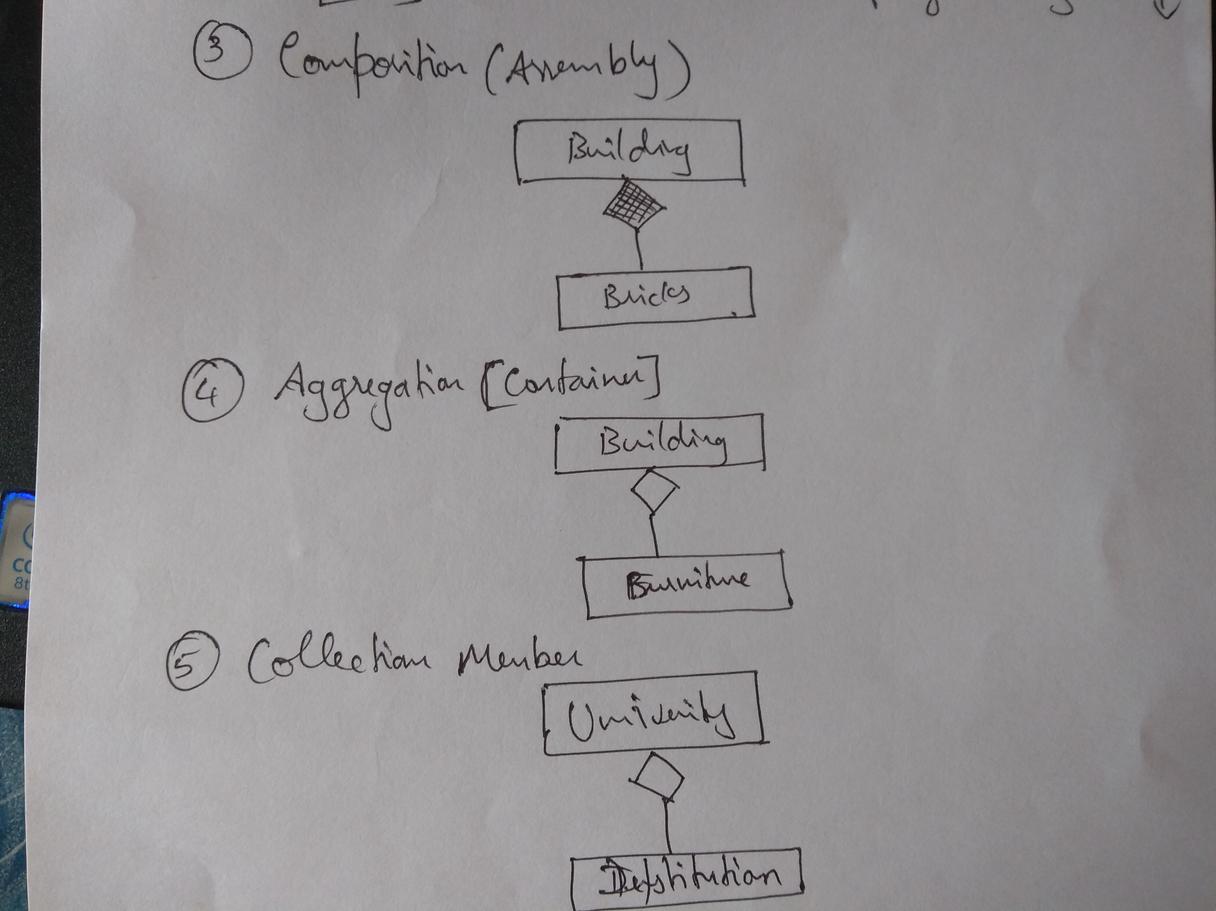
Examples on Relationships

Slide 47

Modeling Structural Relationships
Given an association between two classes
Both rely on each other in some way
Can navigate in either direction
Specifies a structural path across which objects can interact
To model structural relationships
Navigation from object of one class to object of other – data-driven
Specify multiplicity and role names (helps to explain the model)
Mark as an aggregation if one class is structurally a whole compared with classes at the other end that look like parts

Slide 48
Modeling Structural Relationships
Identify the association relationships among classes drawn from an information system for a school
School has one or more departments
Department offers one or more Courses
A particular Course will be offered by only one Department
Department has Instructors and Instructors can work for one or more Departments
Student can attend any number of Courses in a School
Every Course may have any number of Students
Instructors can teach zero or more Courses
Same Course can be taught by different Instructors
Students can be enrolled in more than one School
For every Department, there is exactly one Instructor who is the chairperson

Slide 49
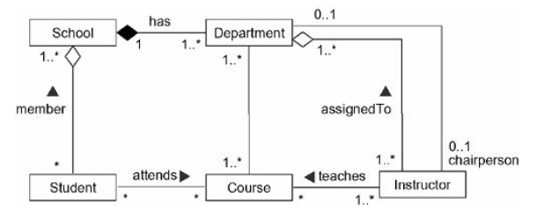
Modeling Structural Relationships

Slide 50
Object Relationship in Code
Association
public class A {
public void doSomething(B b) { }
}
Aggregation
public class A {
private B b1;
public void setB(B b) { b1 = b; } }
Composition
public class A {
private B b1;
public A() {
b1 = new B();
} }

Slide 51
Object Relationship in Code
Generalization
public class A {
...
} // class A
public class B extends A {
....
} // class B
Realization
public interface A {
...
} // interface A
public class B implements A {
...
} // class B

Slide 52
Aggregation vs Composition
Dependency: Aggregation implies a relationship where the child can exist independently of the parent.
For example, Bank and Employee, delete the Bank and the Employee still exist. whereas Composition implies a relationship where the child cannot exist independent of the parent.
Example: Human and heart, heart don’t exist separate to a Human
2.Type of Relationship: Aggregation relation is “has-a”, and composition is “part-of” relation.
3. Type of association: Composition is a strong Association whereas Aggregation is a weak Association.

Slide 53
An Invoice is composed of one or more Entries
An Invoice is created for exactly one Customer
An Invoice is created from one or more CustomerOrders
An Invoice is used to update the AccountsReceivable account
An Inventory is composed of zero or more StockItems
A PackingOrder is initiated from one or more Invoices
A PackingOrder is created from Inventory items
A PackingOrder is used to update the Inventory
A StockOrder is received from a Supplier
A StockOrder is used to update the Inventory
A StockOrder is used to update the AccountsPayable account

Slide 54
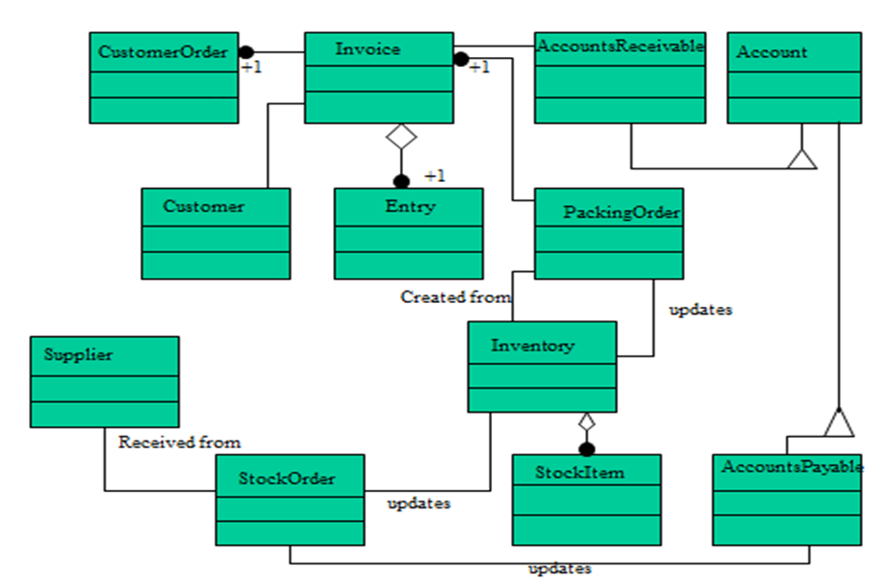

Slide 55

Class Diagram: Example
Models a customer order from a retail catalog.
A customer order from a retail catalog. The central class is the Order. Associated with it are the Customer making the purchase and the Payment. A Payment is one of three kinds: Cash, Check, or Credit. The order contains OrderDetails (line items), each with its associated Item.

Slide 56
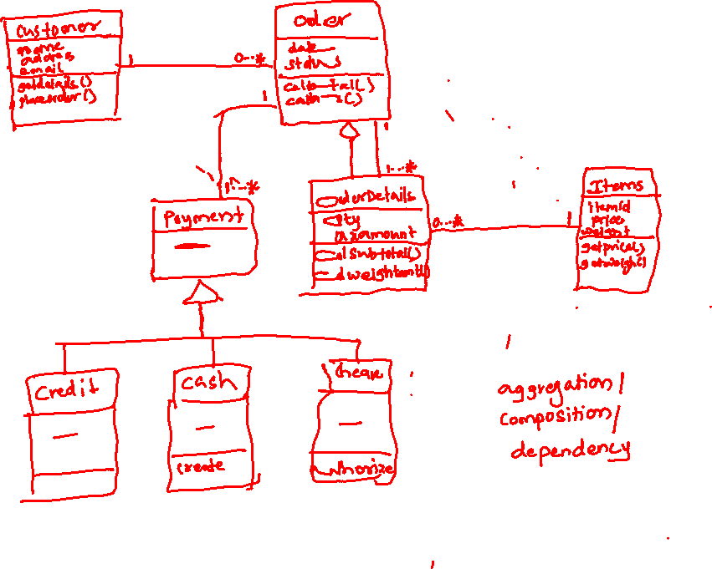

Slide 57
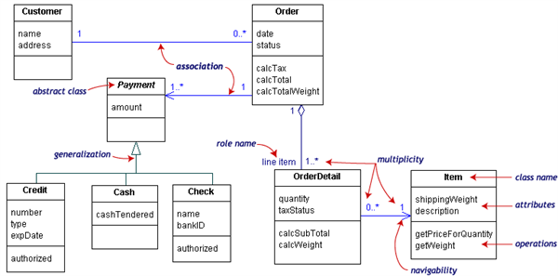

Slide 58
Identifying a list of candidate classes: Example
The library contains books and journals. It may have several copies of a given book. Some of the books are for short term loans only. All other books may be borrowed by any library members for 3 weeks. Member of the library can normally borrow up to 6 items at a time, but members of staff may borrow up to 12 items at one time. Only members of staff may borrow journals.
The system must keep track of when books and journals are borrowed and returned by the user, enforcing the rules described above.

Slide 59
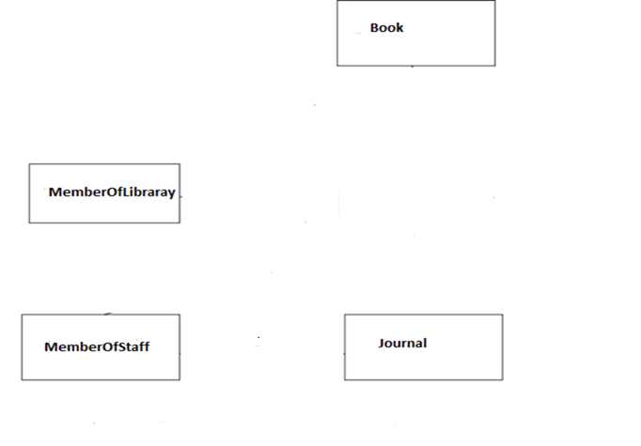
Identified Classes for Library System

Slide 60
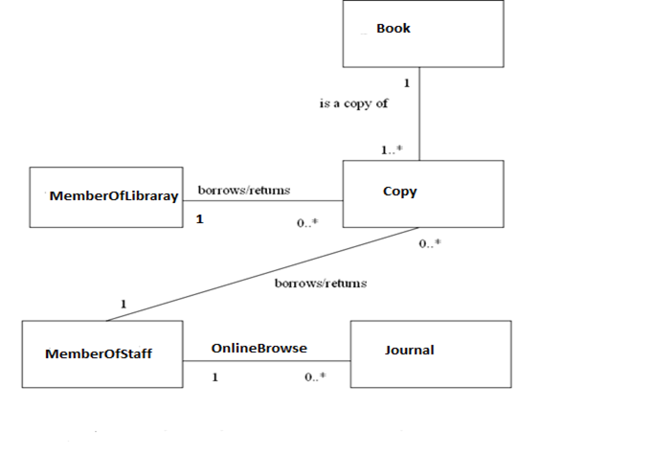
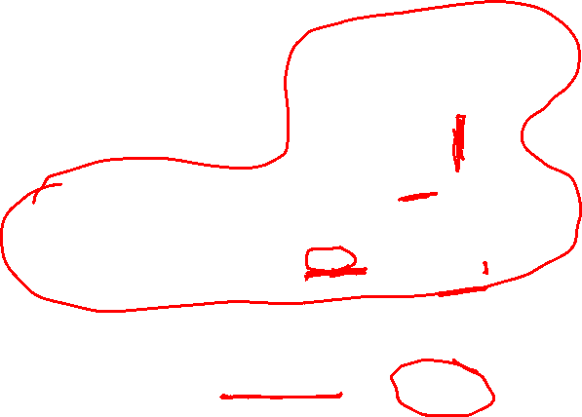
Initial Class model for Library System
.

Slide 61


Revised class model for Library System
.

Slide 62

Class Diagram Example
A hockey league is made up of at least four hockey teams. Each hockey team is composed of six to twelve players, and one player captains the team. A team has a name and a record. Players have a number and a position. Hockey teams play games against each other. Each game has a score and a location. Teams are sometimes lead by a coach. A coach has a level of accreditation and a number of years of experience, and can coach multiple teams. Coaches and players are people, and people have names and addresses.

Slide 63


Slide 64
Design concepts
Functional Independence
Cohesion – is an indication of the relative functional strength of a module
Coupling – is an indication of the relative interdependence among modules

